Slide 1


Zen Wealth
Financial Freedom and Security
The importance of understanding Investment Risk
September 2019
This does not constitute advice. Professional advice should be taken prior to acting on any part of it.
Zen Wealth LLP is an appointed representative of Best Practice IFA Group Limited which is authorised and regulated by the Financial Conduct Authority.

Slide 2
Assessing Risk, Asset Allocation and Modern Portfolio Construction
In the guide, Sources of Investment Return, we looked at the different components which can be blended together to create a portfolio. We explained, how the different asset classes work and how we use knowledge of this to help benefit investors.
In this guide, we take this further, we will look at how we assess risk and more importantly how we then allocate this to different assets to build a portfolio.
The past is not necessarily a guide to future performance

Slide 3
What is Risk
Risks you face
Inflation
Inflation like taxes, eat away at the value of money, and yet many people are unaware that it is there eating away at the money they have put away. They may not notice a smaller balance in their account, but they will definitely be losing buying power. The amount that they can purchase with £1 slowly erodes over time.
Investors need to understand that some savings vehicles fail to pay a return that beats inflation, especially after tax.
Shortfall
Shortfall risk is the impact of failing to meet a long term investment goal. Did you take on enough risk to earn the potential for the required return. Did you take too much risk, and the investment lost value at the wrong time.
Political or Economic Risk
Globally we are facing increasing news headlines highlighting political and economic instability. These factors can and do influence investment markets. Economic factors such as growth, inflation, interest rates will all impact on how your money should be allocated.
Political risks such as changes in government, uncertainty of policy and international conflict can all impact on the performance of an asset.
Market Risk
Whether you hold cash, bonds, property or equities, these assets are exposed to a wide range of factors that can lead to whole markets or some markets to decline together, for example as part of the Financial Crisis.
It is important to understand that our perception of risk as Wealth Managers can sometimes differ from a clients. This leads to challenges for us if we solely rely on quantitative measures of risk, such as “volatility”.
It is important that we take a comprehensive approach which looks to educate our investors about investment risk, as well delving much deeper to understanding a true and complete risk profile.
“Risk” means the possibility of a number of different outcomes resulting from a given action. For example, before you toss a coin, you know the result could be heads, tails, or land on its edge You know one of three outcomes could occur.
In investment terms, it is widely accepted that risk is the volatility of prices and/or returns. However, we believe that this approach alone is dangerous. Clients do not think in mathematical terms. A client would often view risk as the prospect of financial loss, or not having enough money to fund a specific objective.
The past is not necessarily a guide to future performance

Slide 4
The starting point
We will ask you to complete a risk profiling questionnaire, but this is only the start of our conversation about risk. We will use this generalised number to discuss what this might mean for you, it will help to highlight the critical issues which could impact on the suitability of an investment.
It is our job as advisers to ensure that the level of risk you take is appropriate. Just because someone is willing to take risk, it doesn’t mean they should take risk.
Your true risk profile will factor in your “willingness to take risk”, your “ability to take risk” and your “need to take risk”.
Your willingness to take risk, is usually known as your “risk attitude” and we use a questionnaire to help gauge the psychological willingness to take risk.
Your ability to take risk is often referred to as your risk capacity.
Your need to take risk, including the need to accept risk to meet an objective, avoid falling short of a goal or having wealth eroded by inflation.
We will provide you with a detailed “risk-report” this will be agreed with you prior to any recommendations being made.
Willingness
Ability
True risk profile
Need
The past is not necessarily a guide to future performance

Slide 5

Factors influencing risk
We build investment portfolios with various degrees of risk and expected returns and express these variables in simple terms that we hope you understand.
i. Time Horizon and Liquidity Needs
How soon might you need to withdraw money from your investments? The longer an investor holds onto a risky asset the lower the chance there is of obtaining poor cumulative returns.
ii. Risk Appetite
What is your aversion or attraction to risk when risk is defined as defined as “the possibility of loss”?
iii. Net Worth
Generally speaking, the more assets an investor has in reserve, the higher their capacity for risk.
iv. Income and Savings Rate
How much can you save? In the same way that greater wealth enables a greater appetite for risk so too does being able to put more aside regularly.
v. Investment Knowledge
How good is your understanding of the investment you are making and how it behaves over time?
The past is not necessarily a guide to future performance

Slide 6
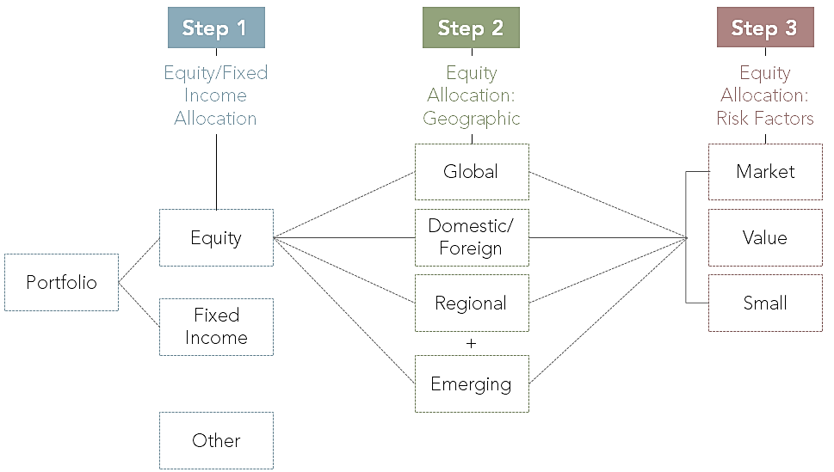
Portfolio Construction
Having reviewed and established the different factors of risk that need to be considered when measuring risk we can start the process of building a portfolio.
Step 1. Determine the basic Equity/Fixed Income split
The portfolios are gradually allocated increasing amounts of equity the more adventurous the portfolio. The greater the proportion of equity in a portfolio, the more risk that portfolio will be exposed to.
Step 2. Determine the International Equity Dimension
The equity component of the portfolios is spread across regions using the MSCI All Countries World Index as a broad benchmark. This helps ensure a well-diversified portfolio and avoids an overweight or bias in any one particular country.
Step 3. Determine the Size & Value Equity Dimension
Factors to consider are:
Risk/Return: Increasing allocation to small and/or value stocks may increase risk, expected return and tracking error but may not increase volatility.
Sensitivity to tracking error: Increased sensitivity to prolonged periods of underperformance to the market.
This diagram illustrates a framework for the construction of portfolios.
The past is not necessarily a guide to future performance

Slide 7

Our Risk Rated Models
Asset Class | Smart Cautious | Smart Balanced | Smart Adventurous
Liquid Assets | 10% | 5% | 3%
Defensive Assets | 28% | 20% | 5%
Fixed Interest Assets | 18% | 14% | 12%
Inflation Linked Assets | 6% | 5% | 5%
Property | 8% | 5% | 5%
Equity | 16% | 27.5% | 35%
Equity Tilts | 12% | 20% | 25%
Emerging Markets | 2% | 3.5% | 5%
The past is not necessarily a guide to future performance

Slide 8
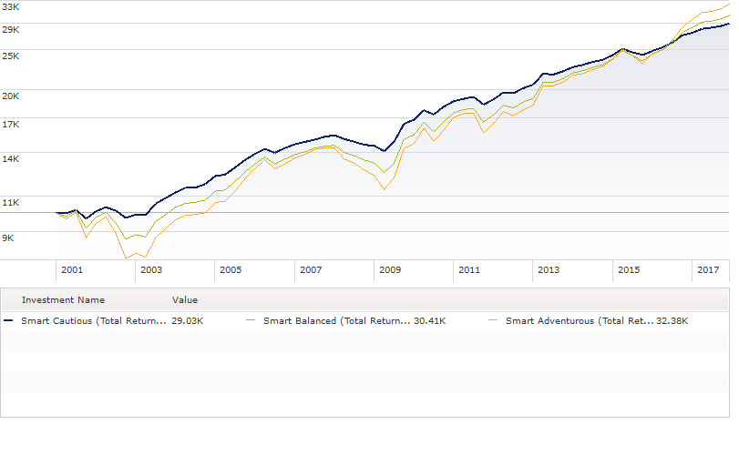
Testing Portfolios
We use a powerful analysis tool which gives us access to independent returns information to back test our models.
It is important when deciding which portfolio is most suitable for your planning needs that you understand the risk you are taking and the potential for capital loss.
This graph shows what would have happened to the investment of £10,000 into different risk-rated portfolios would have achieved since December 29th 2000.
The past is not necessarily a guide to future performance

Slide 9
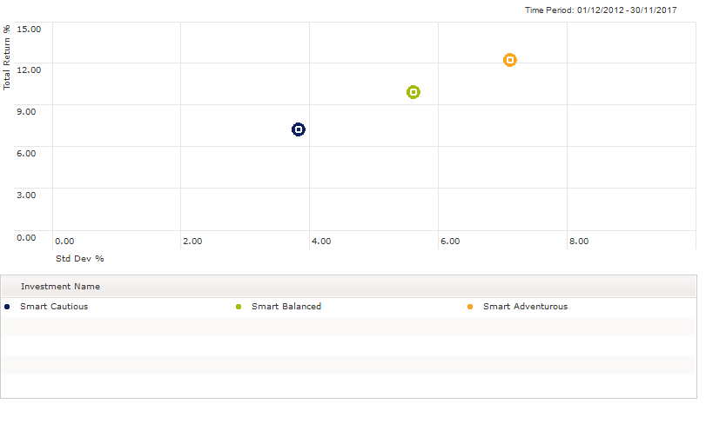
Risk versus reward
It is important to consider the balance for taking risk, the chart opposite illustrates over the past five years how the portfolios have compensated investors for either taking risk or reducing risk.
There will be periods where taking risk does not pay dividends, and therefore you need to be comfortable that you will not need access to the money in the short term. Investment risk, can sometimes present difficult decisions such as deferring retirement or putting off a purchase.
Our risk rated solutions can help ease that journey, as each of the portfolios will be comprised of a wide range of assets, some will be stable and there daily price movements will be small, other assets, such as Emerging Markets will have large movements in the asset price daily.
Your adviser will discuss with you an appropriate balance between safe assets and growth assets.
The past is not necessarily a guide to future performance

Slide 10
Level 30
The Leadenhall Building
122 Leadenhall Street
London
EC3V 4AB
Tel: 020 3753 4638
Zen Wealth LLP is an appointed representative of Best Practice IFA Group Limited which is authorised and regulated by the Financial Conduct Authority.

